Slide 1
WorldGuard: Software Isolation in RISC-V and Vyond
Sungkeun Kim
Security&Privacy Team
Samsung Research
July31, 2025

Slide 2
About me
Working on security in computer systems and architecture
Thesis – Cache Design and Analysis for Mitigating Hardware Security in Multicore Systems
Developed on Galaxy phones before Ph.D. study
Android framework
Like open-source projects
H2database, Gem5, Intel RAAD, Chipyard
Now vyond
Like Running

Slide 3
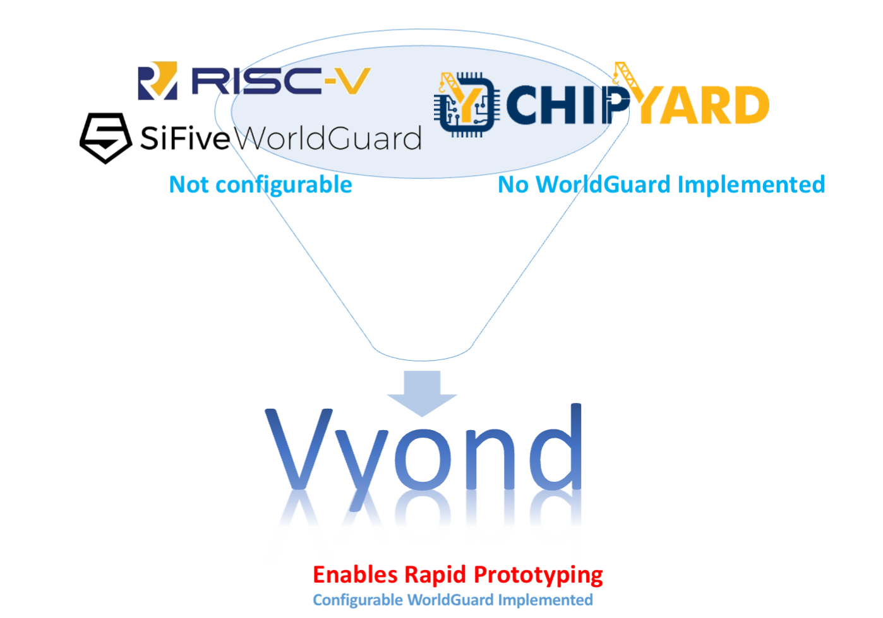
Vyond: Flexible and Rapid WorldGuard-based Security Prototyping using Chipyard

Slide 4
Agenda
Software (Runtime) isolation for Trusted Execution Environment
WorldGuard Introduction
WorldGuard Implementation on Chipyard
Related techniques and future potential

Slide 5
Trusted Execution Environment

Slide 6
What’s wrong with my phone?
What’s wrong with my phone and server?
We can do so many things with it.
Banking, games, videos, etc.
Might be something malicious together..
A larger attack surface
It may happen the same thing in clouds services
Many services from different companies run in the physically the same machine
Sharing the physical resource is efficient but dangerous!
Notes:
What is wrong with my phone?
At one level, nothing. It is a superb device that can do hundreds of tasks that once upon a time you needed multiple devices to achieve… but therein lies a problem.
With that ability to do many tasks comes masses of software. The more software, the larger the number of places where there may be a security issue (a larger “attack surface”) and the higher the likelihood that vulnerabilities will be found. To work around that issue, the Trusted Execution Environment (TEE) was developed by a consortium of concerned parties; from network operators, through manufacturers, to OS vendors.

Slide 7
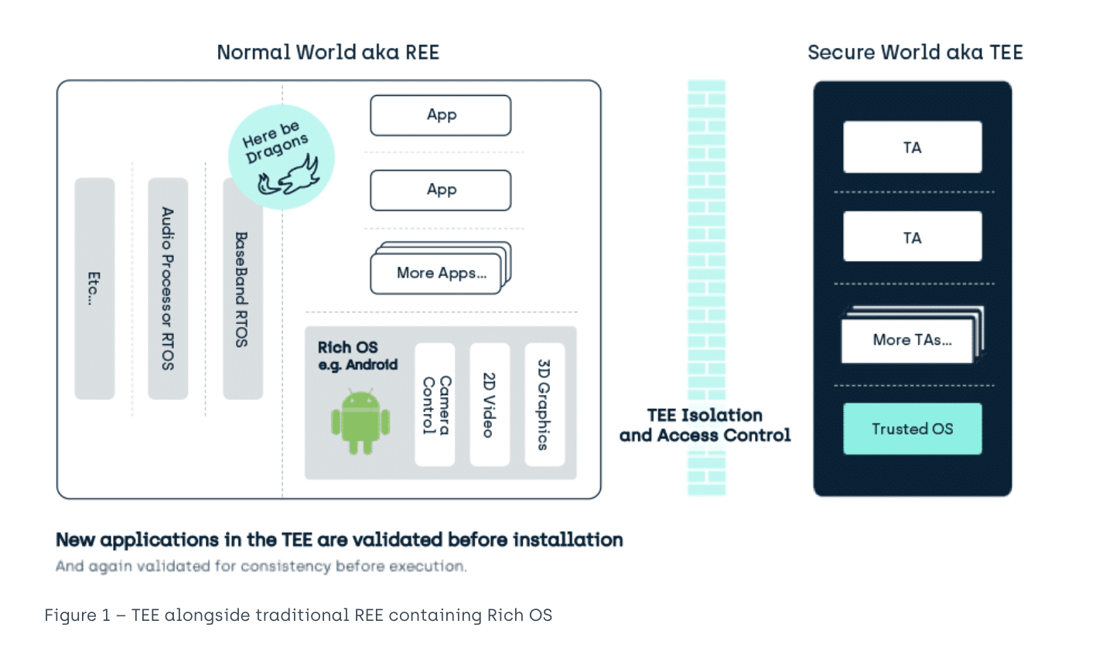
Trusted Execution Environment
Guarantees Integrity and Confidentiality
Examples
Intel – SGX/TDX
Arm – TrustZone/Realms
RISC-V – Keystone/Pengai
Samsung – TrustWare (Tursted OS)
WorldGuard provides isolation
https://www.trustonic.com/technical-articles/what-is-a-trusted-execution-environment-tee/
Notes:
A Trusted Execution Environment (TEE) is an environment for executing code, in which those executing the code can have high levels of trust in the asset management of that surrounding environment because it can ignore threats from the “unknown” rest of the device^{i}. Hence TEE stands for Trusted Execution Environment and to distinguish them from the uncertain nature of applications in the REE (REE? Wait a second…), applications in the TEE are known as Trusted Applications (TAs). Generally, the rest of the device hosts a feature Rich OS like Android™, and so is generically known in this context as the REE (Rich Operating System Execution Environment).
Trust in a Trusted Execution Environment (TEE)
There are many interpretations of what is meant by Trust. In the TEE it is used to imply that you may have a higher level of trust in validity, isolation and access control in items (assets) stored in this space, when compared to more general purpose software environments. This then ripples down to an assertion that the Trusted OS and Trusted Applications executing inside that space are more trustworthy.
Why is a Trusted Execution Environment more Trustworthy?
Secure start-up
In the TEE, that Trust requires that all TEE related assets, code, the underlying Trusted OS and its support code, have been installed and started through a methodology that requires its initial state to be as expected by the designers (i.e. EVERYTHING is signature checked, immutable, or held in isolation).
TEEs only accept code for execution that has been:
Appropriately authorized
And where that authorization has been checked by other authorized code
And that includes everything from after ROM^{ii} boot
(you can consider the ROM code authorized by its presence).
TA’s can only directly access their own data (including key) assets:
There is no method for a TA to directly access assets of other TAs or other components of the TEE.

Slide 8
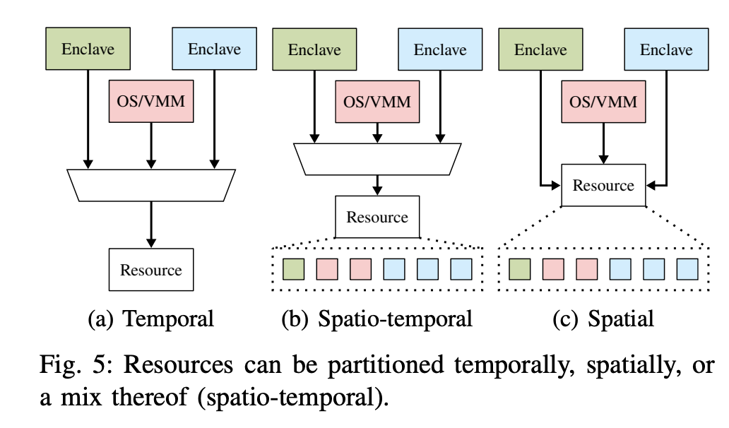
Taxonomy of Isolation strategies
Partitioning Resources
https://arxiv.org/pdf/2205.12742
Notes:
A Trusted Execution Environment (TEE) is an environment for executing code, in which those executing the code can have high levels of trust in the asset management of that surrounding environment because it can ignore threats from the “unknown” rest of the device^{i}. Hence TEE stands for Trusted Execution Environment and to distinguish them from the uncertain nature of applications in the REE (REE? Wait a second…), applications in the TEE are known as Trusted Applications (TAs). Generally, the rest of the device hosts a feature Rich OS like Android™, and so is generically known in this context as the REE (Rich Operating System Execution Environment).
Trust in a Trusted Execution Environment (TEE)
There are many interpretations of what is meant by Trust. In the TEE it is used to imply that you may have a higher level of trust in validity, isolation and access control in items (assets) stored in this space, when compared to more general purpose software environments. This then ripples down to an assertion that the Trusted OS and Trusted Applications executing inside that space are more trustworthy.
Why is a Trusted Execution Environment more Trustworthy?
Secure start-up
In the TEE, that Trust requires that all TEE related assets, code, the underlying Trusted OS and its support code, have been installed and started through a methodology that requires its initial state to be as expected by the designers (i.e. EVERYTHING is signature checked, immutable, or held in isolation).
TEEs only accept code for execution that has been:
Appropriately authorized
And where that authorization has been checked by other authorized code
And that includes everything from after ROM^{ii} boot
(you can consider the ROM code authorized by its presence).
TA’s can only directly access their own data (including key) assets:
There is no method for a TA to directly access assets of other TAs or other components of the TEE.

Slide 9
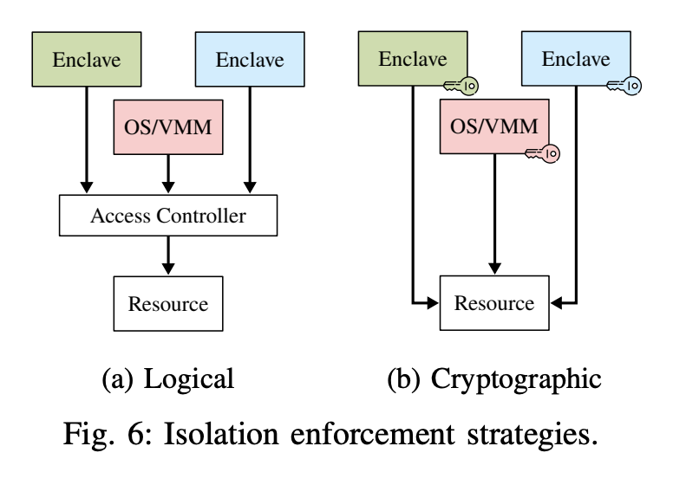
Taxonomy of Isolation strategies
Enforcement
Logical
Cryptographical
https://arxiv.org/pdf/2205.12742
Notes:
A Trusted Execution Environment (TEE) is an environment for executing code, in which those executing the code can have high levels of trust in the asset management of that surrounding environment because it can ignore threats from the “unknown” rest of the device^{i}. Hence TEE stands for Trusted Execution Environment and to distinguish them from the uncertain nature of applications in the REE (REE? Wait a second…), applications in the TEE are known as Trusted Applications (TAs). Generally, the rest of the device hosts a feature Rich OS like Android™, and so is generically known in this context as the REE (Rich Operating System Execution Environment).
Trust in a Trusted Execution Environment (TEE)
There are many interpretations of what is meant by Trust. In the TEE it is used to imply that you may have a higher level of trust in validity, isolation and access control in items (assets) stored in this space, when compared to more general purpose software environments. This then ripples down to an assertion that the Trusted OS and Trusted Applications executing inside that space are more trustworthy.
Why is a Trusted Execution Environment more Trustworthy?
Secure start-up
In the TEE, that Trust requires that all TEE related assets, code, the underlying Trusted OS and its support code, have been installed and started through a methodology that requires its initial state to be as expected by the designers (i.e. EVERYTHING is signature checked, immutable, or held in isolation).
TEEs only accept code for execution that has been:
Appropriately authorized
And where that authorization has been checked by other authorized code
And that includes everything from after ROM^{ii} boot
(you can consider the ROM code authorized by its presence).
TA’s can only directly access their own data (including key) assets:
There is no method for a TA to directly access assets of other TAs or other components of the TEE.

Slide 10
WorldGuard

Slide 11
Introduction to WorldGuard (WG)
A hardware-based software isolation solution for RISC-V cores
It leverages logical enforcement strategy to isolate
WG provides software execution contexts known as "worlds", beyond which software cannot reach.
World is referred to World ID (WID)

Slide 12
Key Concepts
A wg-aware core
Contains WID registers needed to mark transactions with WID associated with each active privilege level.
A wgMarker
Adds the active WID to bus transaction passing through them.
A wg checker
Accept or reject transactions based on:
Physical address, WID, transaction type (read or write)
Accepted transaction are passed downstream to the target resource.
Rejected transaction generates an interrupt or exception.
The trusted World ID
WID authorized to access WG configuration registers.

Slide 13
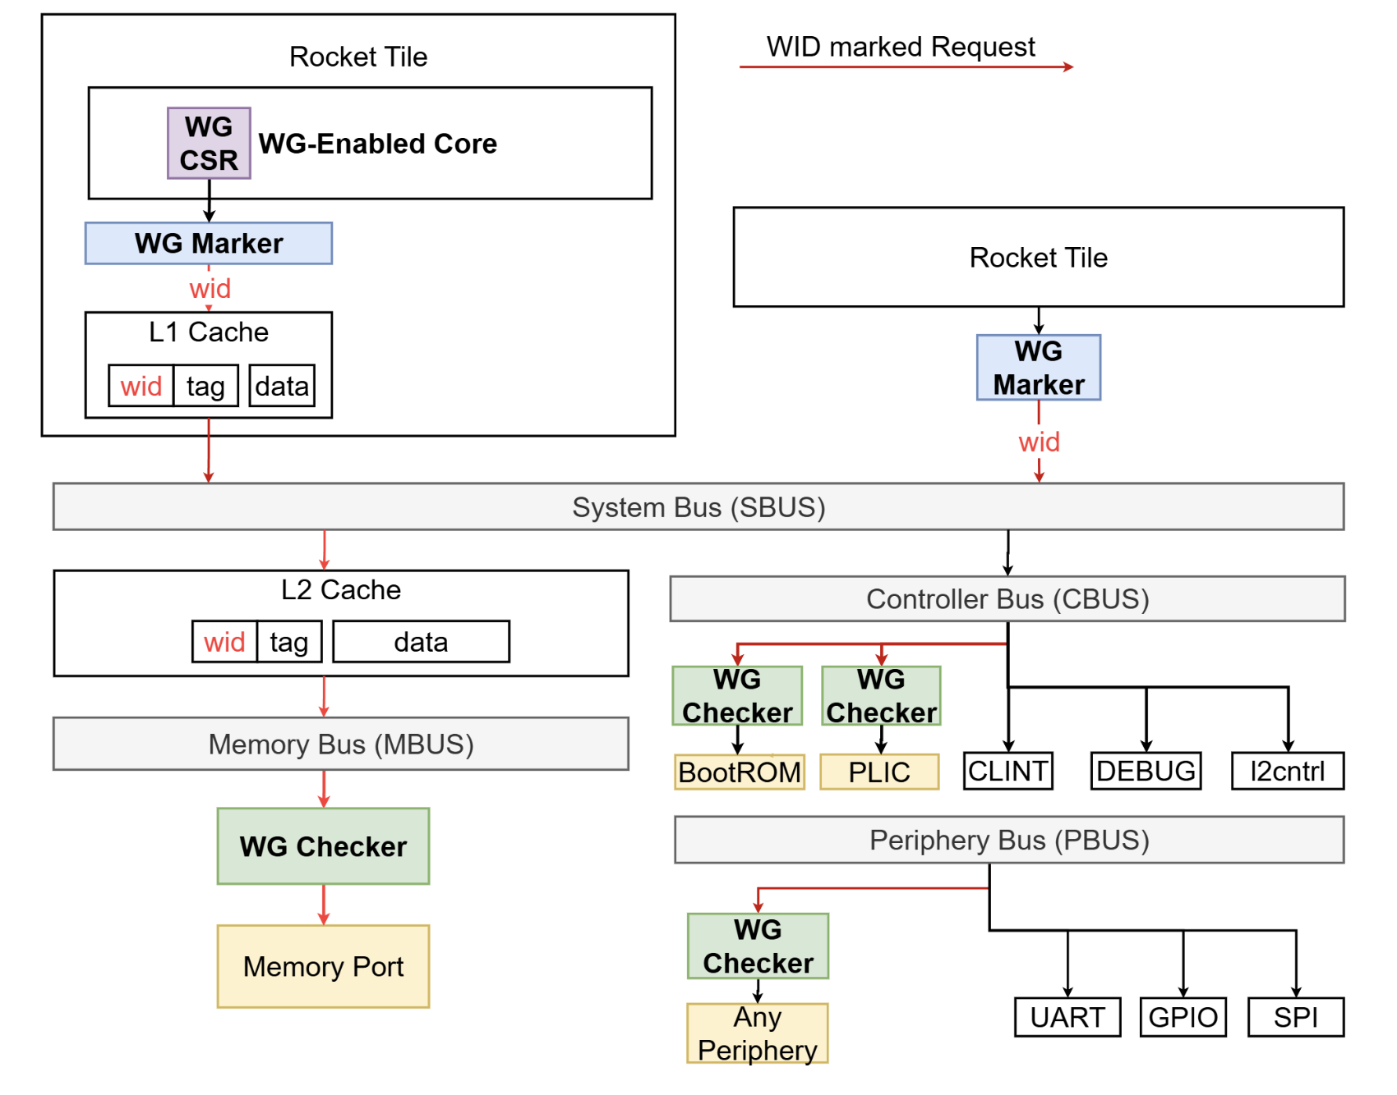
Overview

Slide 14
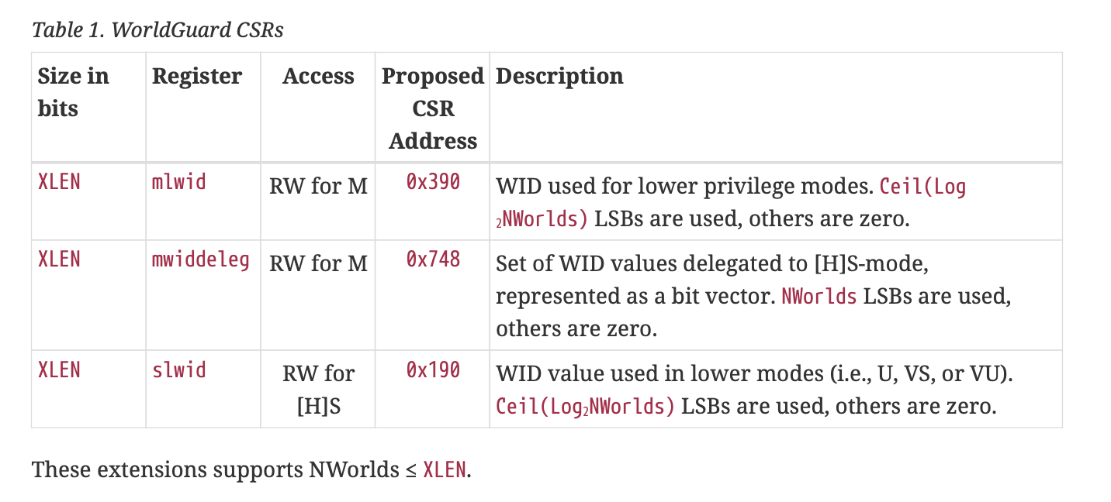
A wg-aware core (CSR+Marker)
A WG-aware core integrates wgMarker with additional internal registers and CSRs so that different privilege modes use different WIDs.
WID CSRs

Slide 15
Worlds allocation example
World 1
World 2
World 3
Not running
U-mode
App
App
App
App
App
App
App
App
App
Running
S-mode
World 6
Operating System
M-mode
World 7
Security Monitor (SM)
S/W

Slide 16
Worlds allocation example
World 1
World 2
World 3
Not running
U-mode
App
App
App
App
App
App
App
App
App
Running
S-mode
World 6
Operating System
M-mode
World 7
Security Monitor (SM)
S/W
H/W
WG-Aware Core
WG CSRs
WG CSR
slwid
?
mlwid
?
Control
Logic
mwiddeleg
?
wid

Slide 17
Worlds allocation example
World 1
World 2
World 3
Not running
U-mode
App
App
App
App
App
App
App
App
App
Running
S-mode
World 6
Operating System
① Booting
World 7
M-mode
Security Monitor (SM)
S/W
H/W
WG-Aware Core
WG CSR
slwid
?
mlwid
0x6
Control
Logic
mwiddeleg
0b00001110
wid

Slide 18
Worlds allocation example
World 1
World 2
World 3
Not running
U-mode
App
App
App
App
App
App
App
App
App
Running
② Context Switch
World 6
S-mode
Operating System
M-mode
World 7
Security Monitor (SM)
S/W
H/W
WG-Aware Core
WG CSR
slwid
0x2
mlwid
0x6
Control
Logic
mwiddeleg
0b00001110
wid

Slide 19
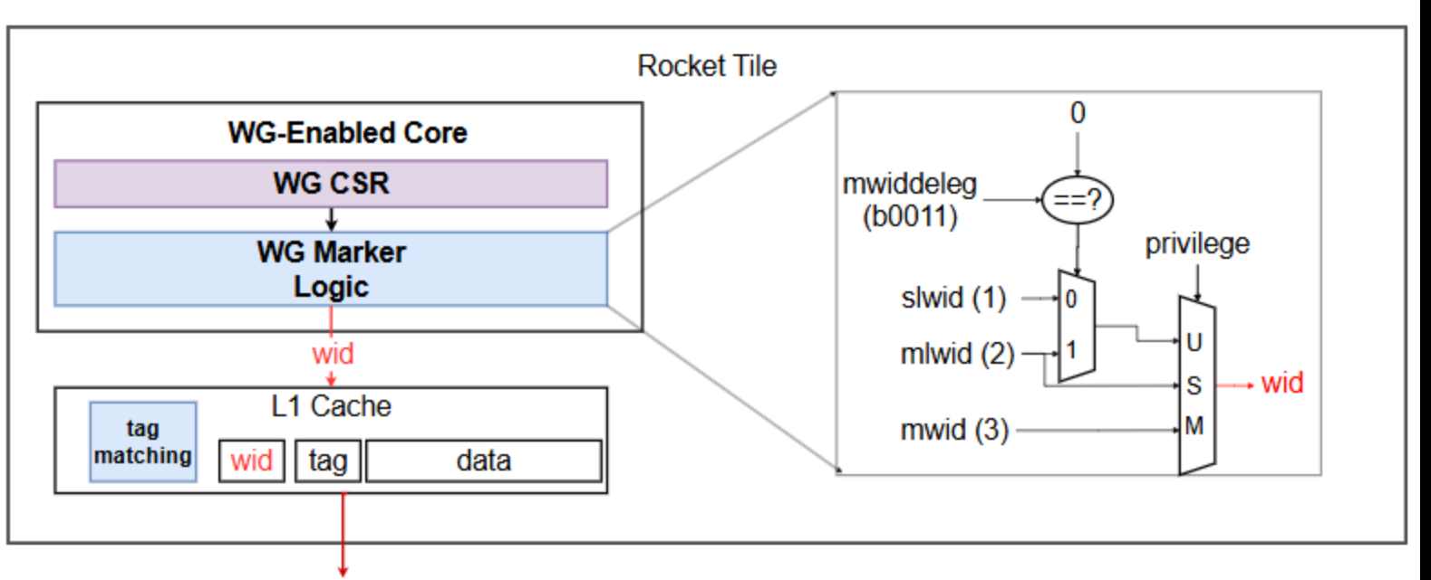
WID selection logic

Slide 20
wgChecker
The checker monitors a fixed physical address range reject or accept the transaction.
Reject: interrupt / exception
Accept: send the transaction to downstream
Slots can specify a rule for a contiguous subset of addresses
Read/Write permissions for each world

Slide 21
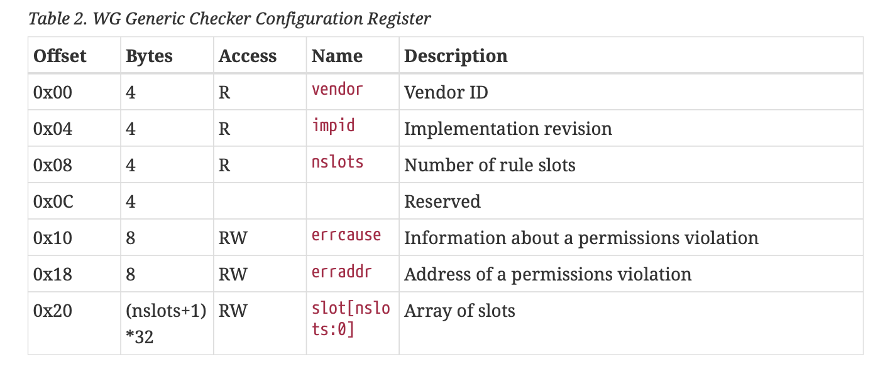
wgChecker – Configuration Register

Slide 22
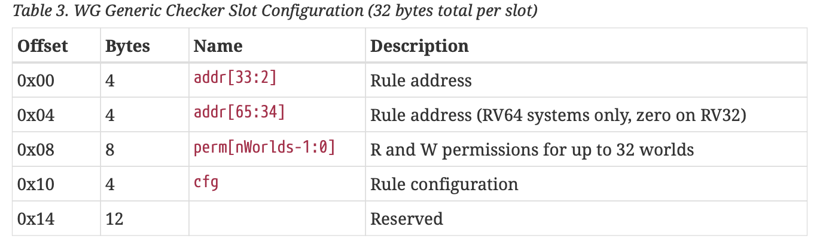
wgChecker – Slot Register

Slide 23
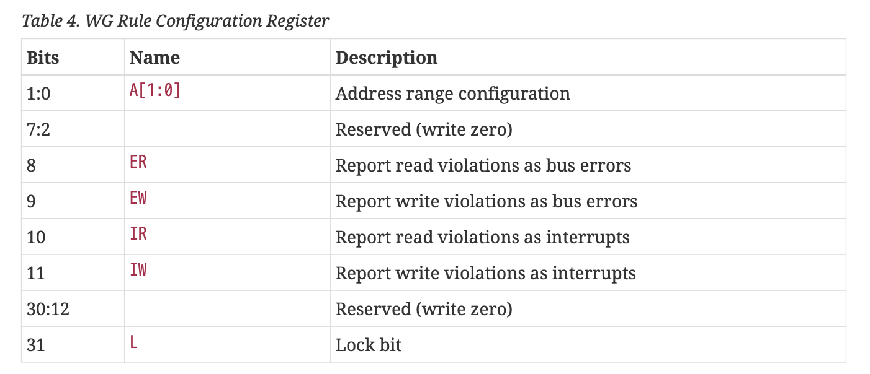
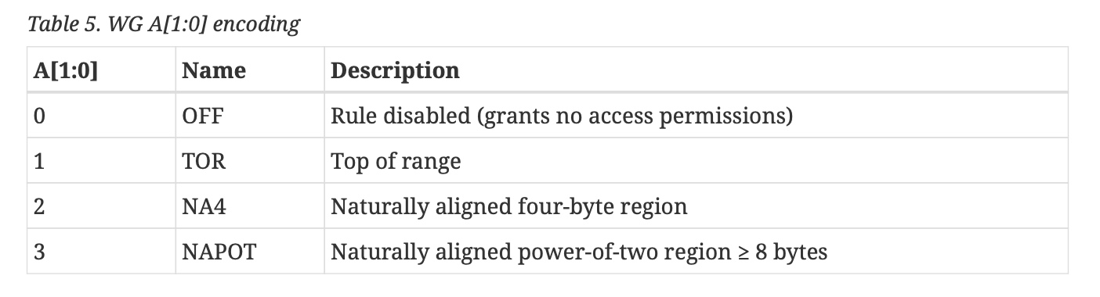
wgChecker – Rule register

Slide 24
BootROM and wgChecker
Configuration:
m-mode (WID 7) can read the entire ROM region.
For RW without the permission, raise bus interrupt.
NAPOT for addressing encoding
wgc_rom
31
11
10
9
8
7
2
1
0
0
1
1
0
0
0
2
0x6004000
L
IW
IR
EW
ER
A
0x0001_ffff
ROM
0x10
0xc02
cfg
Slot[1]
0b10 00 00 00 00 00 00 00
perms
0x8
0x0001_0000
address
0x0
0x5fff

Slide 25
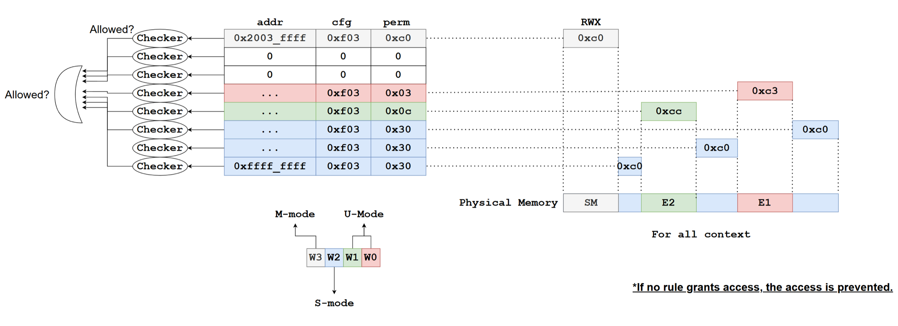
DRAM and wgChecker

Slide 26
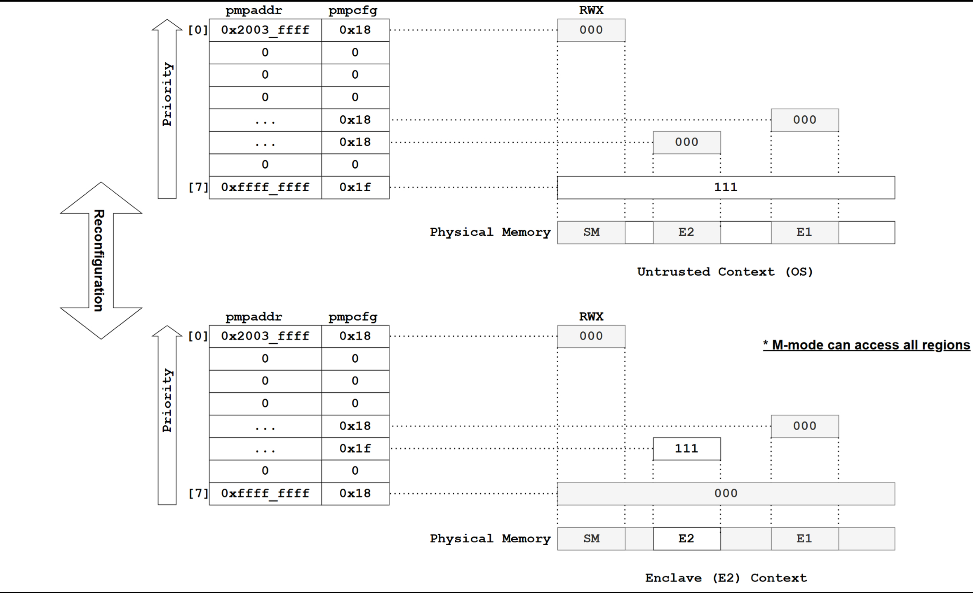
DRAM and PMP

Slide 27
WorldGuard Implementation on Chipyard

Slide 28
What is chipyard?
A unified framework for agile generator-based SoC development
It provides a kind of glue for a general SoC design to connect target design flows
Key features:
Chisel - Reusable by a high-level HDL.
Single source multiple targets
FPGA, Simulation, ASIC
Ecosystem – many available generators
AI Accelerators – Gemmini, NVDLA
RISC-V Cores – Rocket, Boom, Ibex

Slide 29
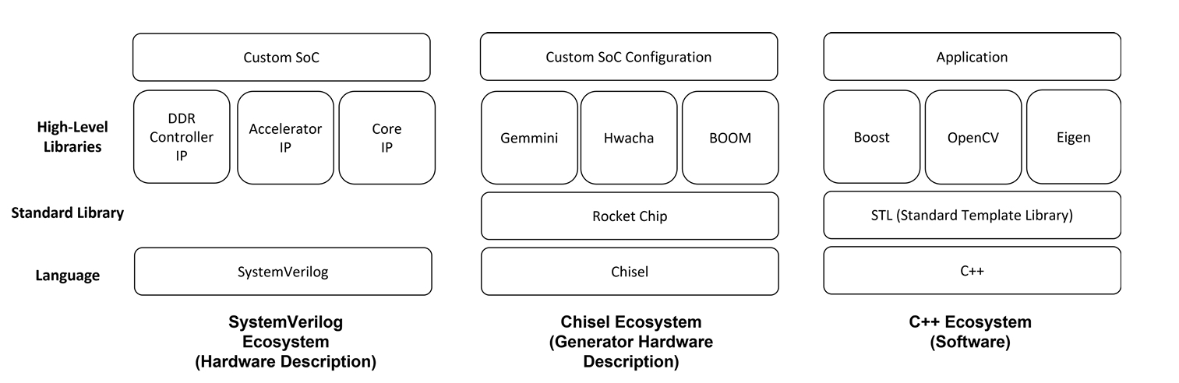
Quick Prototyping: generators on top of standard library
https://www2.eecs.berkeley.edu/Pubs/TechRpts/2022/EECS-2022-247.pdf

Slide 30
Chisel – Hardware Construction Language
Chisel is a hardware construction language embedded in Scala that lets you write flexible, type-safe, and reusable code to generate Verilog for digital circuit design.
Clock and Reset is automatically wired-up
Bulk IO connection is possible (e.g., IO Bundle)
Parameterized Modules

Slide 31
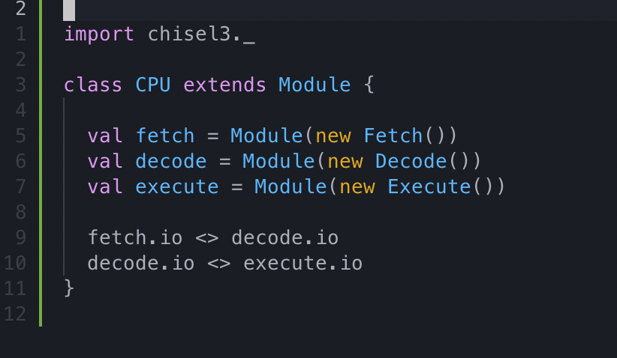
Chisel – Hardware Construction Language (example)
CPU Top

Slide 32
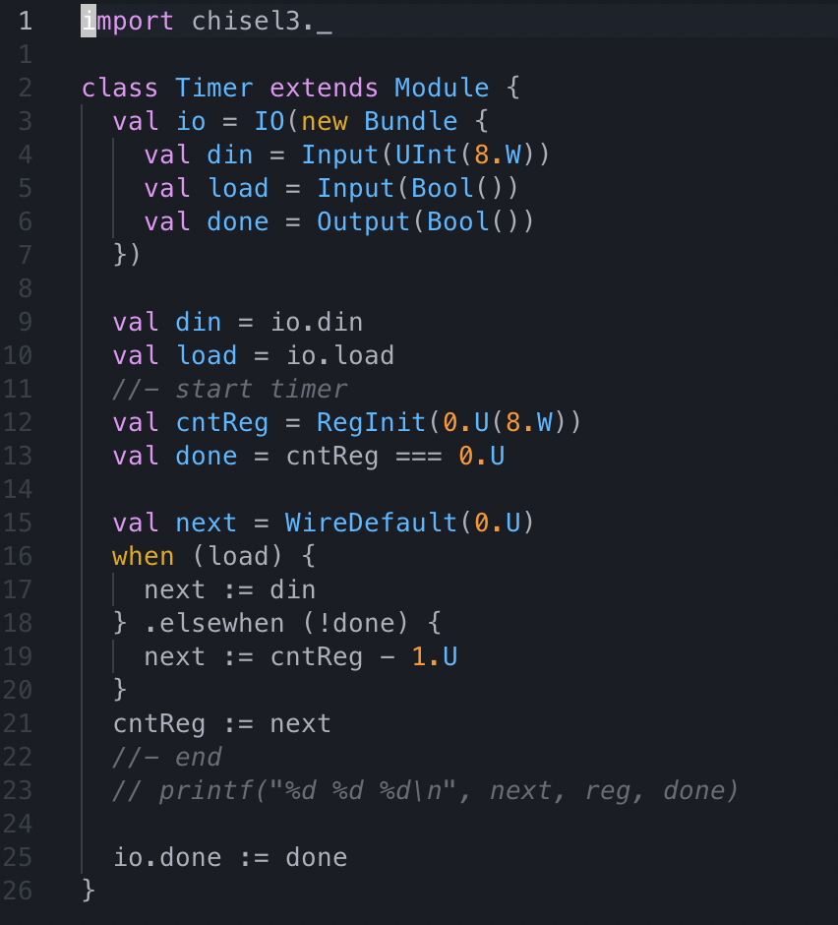
Chisel – Hardware Construction Language (example)
Timer

Slide 33
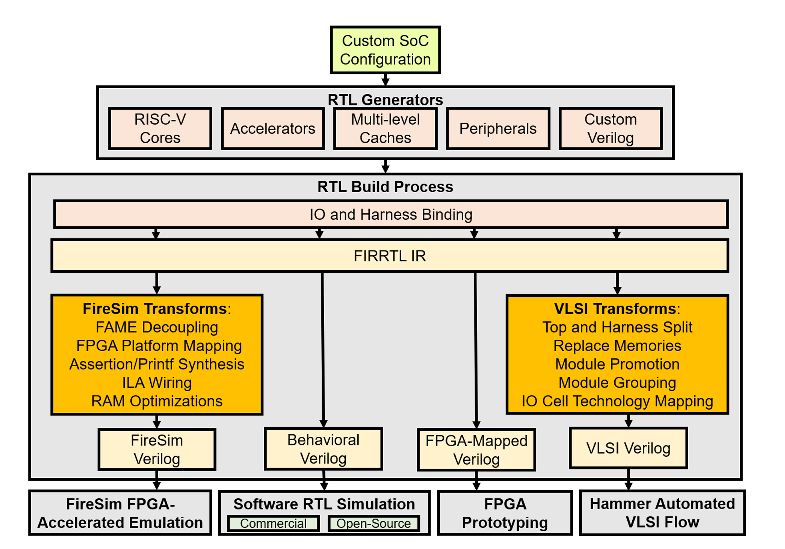
Single source multiple targets
https://www2.eecs.berkeley.edu/Pubs/TechRpts/2022/EECS-2022-247.pdf

Slide 34
WorldGuard Implementation
Rocket Core Extension
WG CSR and wgMarker logic
Bus extension – TileLink
New field for WID
Extension for memory hierarchy
TLB, I-Cache, D-Cache, Last Level Cache
wgMarker and wg checker
Standalone generator

Slide 35
WorldGuard Implementation – wg-aware core
Extend Rocket Core and Tile
Add code snippet
New CSR
Control logic
Propagate WID to downstream (tlb, icache, cache)

Slide 36
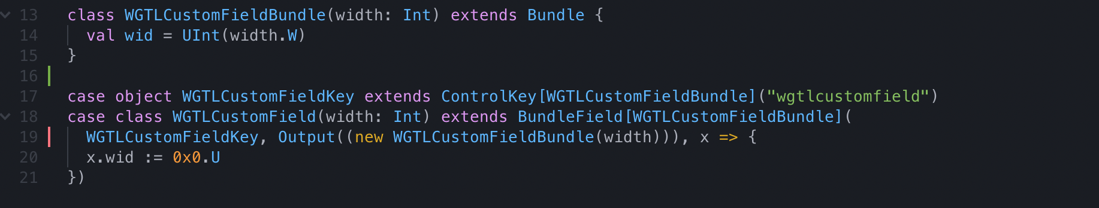
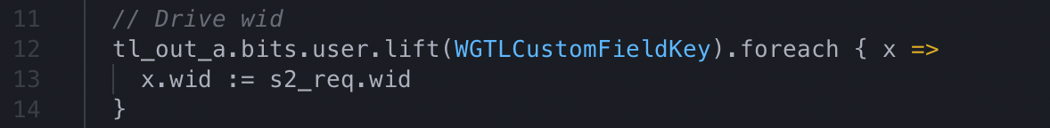
WorldGuard Implementation – bus extension
Rocket SoC employs TileLink Bus
Use reserved field for user extension
Simple to extend (no need to modifies all the source files for IO)
Show code snippet
CustomField
DCache

Slide 37
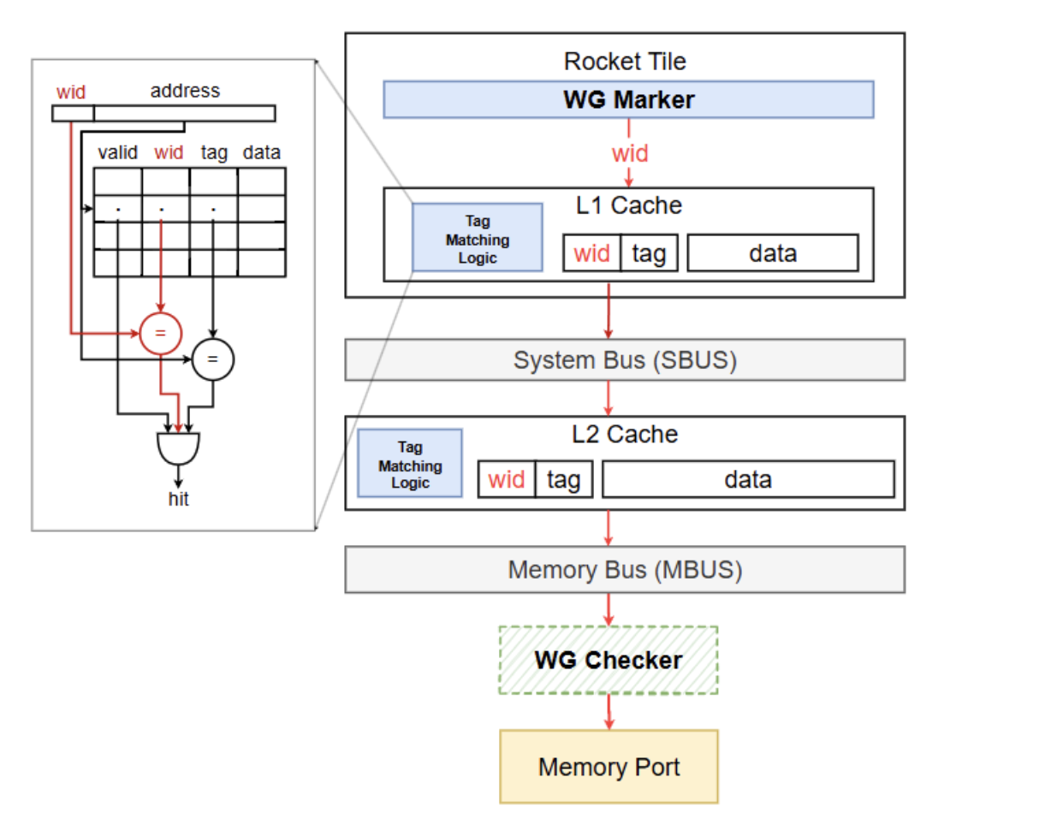
WorldGuard Implementation – cache extensions
WID is used for tag matching
hit if both tag and wid match

Slide 38
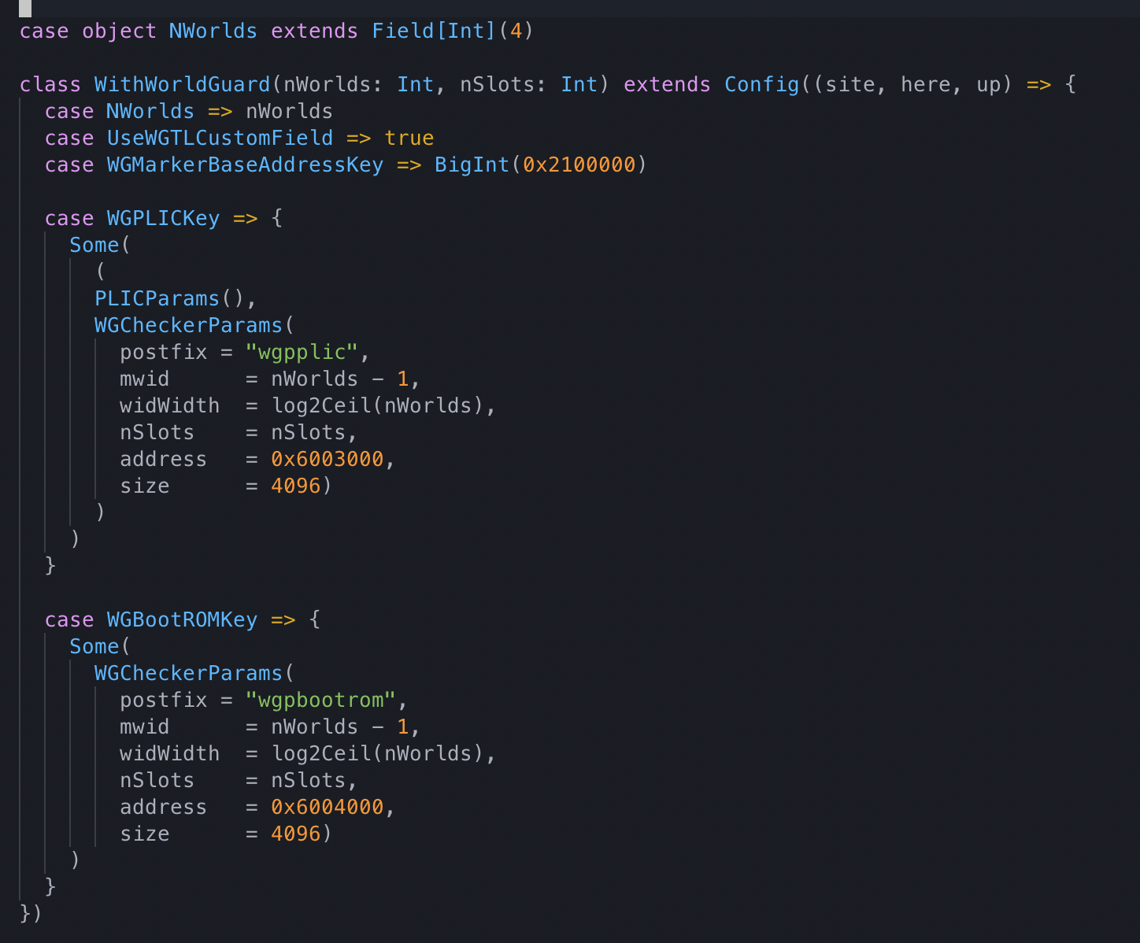
WorldGuard Implementation – Integration to Rocket SoC

Slide 39
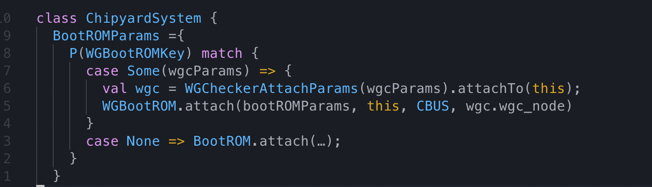
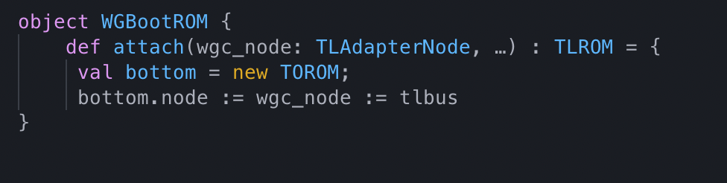
WorldGuard Implementation – Integration to Rocket SoC
Top Module
Simple to connect components

Slide 40
Related works and future work

Slide 41
PMP and WorldGuard
“The WorldGuard solution does not replace the RISC-V core Physical Memory Protection (PMP) mechanism or the Memory Management Unit (MMU), but can coexist with those mechanisms.” — SiFive WG Tech. Paper

Slide 42
PMP and WorldGuard
 | PMP | WorldGuard
Access Check | Performed at core, before any transaction is initiated on the bus Only checked accesses from cores | Performed at the resources, can be out of core Can check accesses from any initiators
Granularity | Limited to #PMP entries (Not scalable) | Limited to #wgChecker entries (Not scalable)
Performance | Need synchronization bet. Cores Need PMP entry update if enclave switch | No need synchronization bet. Cores Need cache sanitization for dynamic config.

Slide 43
IOMMU and WorldGuard
WorldGaurd
No address translation
Region-based permission check
Coarse-grain due to limited slots
Small code base
IOMMU
Address Translation (VA to PA)
Must access page tables in memory
Page-based permission check
Supports virtualized environments
Itself a device; has own initiator port to access page tables

Slide 44
WorldGuard > PMP > MMU/IOMMU
WorldGuard provide the coarsest and least-dynamic configurable isolation scheme, and effectively create a few very large worlds in the system at boot time.
Within worlds, PMP can be used to isolate an arbitrary number of physical memory partitions that may vary dynamically.
Within PMP physical memory partitions, MMU and IOMMU provides flexible dynamic page-level translation and protection for both compute and IO

Slide 45
Collaboration of PMP and WorldGuard for complete isolation
Isolate statically allocated regions (FW, I/O devices) using WorldGuard
No extra works are required for enclave migration (e.g., PMP updates)
Useful in Robot, Car, and IoT devices with many sensors
Isolate dynamically allocated regions (OS, enclaves) using PMP
It is easy for security monitor to reallocate memory region for difference enclaves

Slide 46
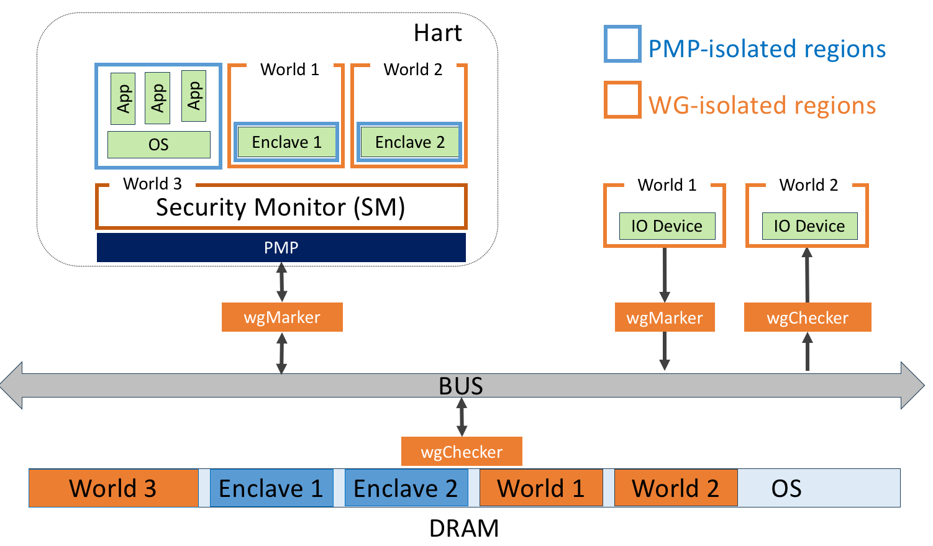
Collaboration of PMP and WorldGuard for complete isolation

Slide 47
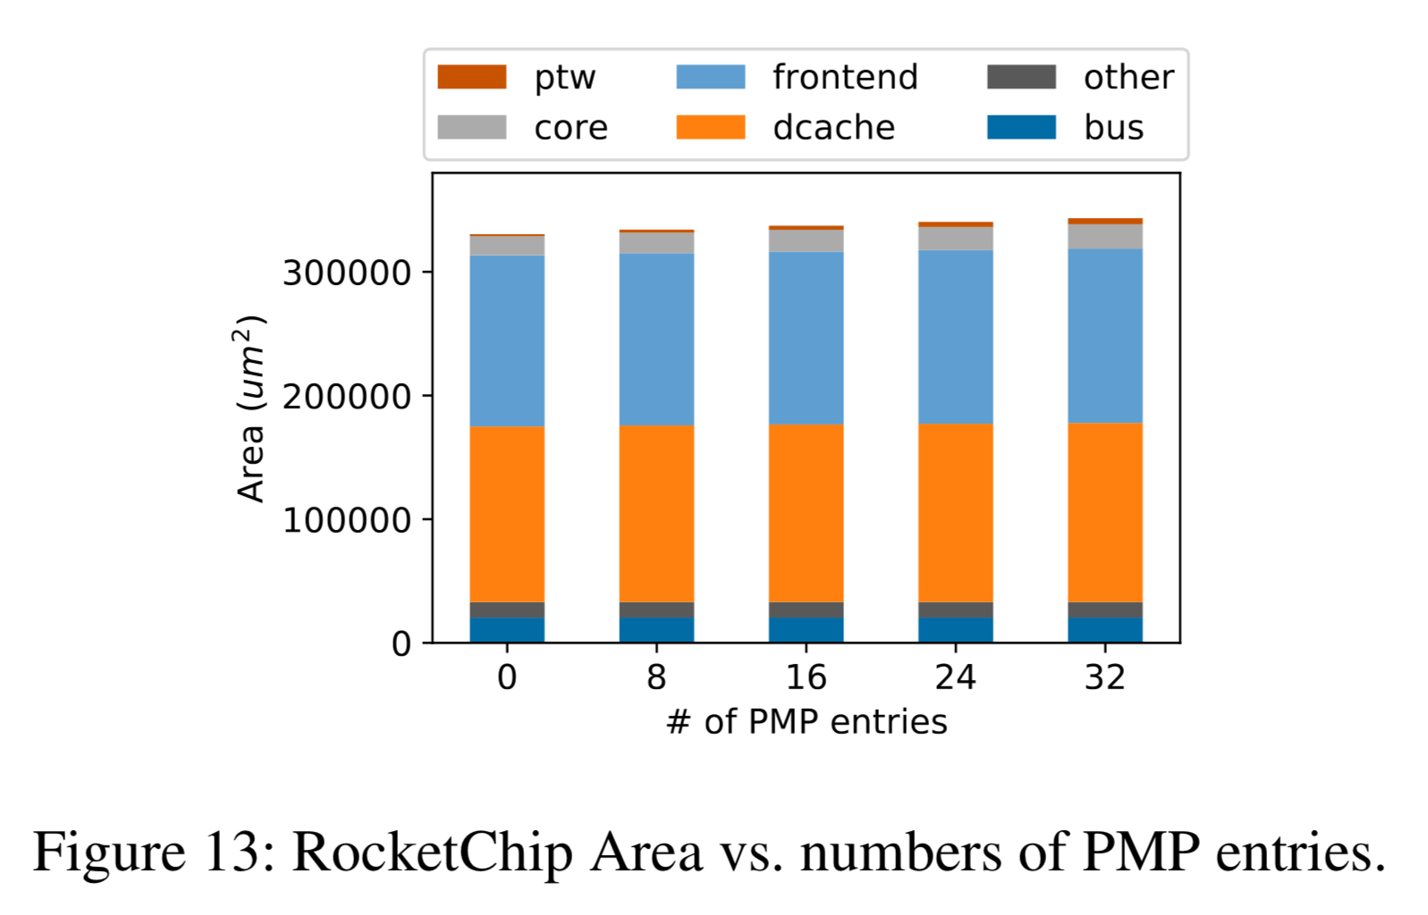
Discussion - Number of World? Number of Slots?
Current Max #Worlds = 32
Current #Slots are not limited to the spec.
Not increase performance due to parallel address matching and permission check
But limited to area budget

Slide 48
Discussion – Core-driven vs. Process-driven

Slide 49
Discussion – Research topics

Slide 50
Thank you!
Sungkeun Kim
sk84.kim@samsung.com

